Slide 1
Becoming a Geni(e)us: How to get the most out of Databricks Genie Agents
DATA SATURDAY HOLLAND – 10TH OCTOBER 2026
Ashley Warren
Senior Analytics Consultant at Advancing Analytics
Notes:
Section is 5 mins

Slide 2












Thank you sponsors!
ata Saturdays

Slide 3




Ashley Warren
WHO AM I?
Senior Analytics Consultant at Advancing Analytics
7+ years building Power BI reports and models
Background was in Data Visualisation & Business Analytics
Recently shifted more towards Analytics Engineering & Data Modelling
Regular community speaker - session #13 of 2026
I co-organise the Bristol Fabric and Power BI user group
I share tips & tricks on Mondays on LinkedIn
/aw2571

Slide 4
Agenda
BECOMING A GENI(E)US
01
Which Genie do I mean?
02
Getting into the Tech
03
Genie Governance
04
Summary
05
Q&A

Slide 5
Which Genie do I mean?
PART ONE
Why can’t we just say Genie
Notes:
Section is 10m

Slide 6






Introducing the Genie Family
AI coworker that sits across all of your data
Domain specific talk to your data solution
Agentic coding tool within Databricks
Genie
Agentic app development inside Databricks
An agent to monitor and fix pipeline issues
Genie Ontology
The underpinning layer that gives the Genie products awareness of your business context

Slide 7
But they weren’t always called Genie Agents
Genie Rooms
Genie Spaces
Genie Agents
Before the GA of Genie
Before GA - July 26
July 26 - present
Before the General Availability of AI/BI Genie & Genie Spaces, the original working name was Genie Rooms. They first appear in June 2024
When AI/BI Genie went GA in June 2025, the Rooms feature was officially named Genie Spaces
Announced at Summit, Genie Spaces were renamed to Genie Agents to reflect the additional capabilities they now have

Slide 8
Getting into the tech
PART TWO
Time for a demo!
Notes:
Section is 5m

Slide 9
Why you shouldn’t use General Instructions for everything

Slide 10
How would Genie answer: "What are our trends for best-selling products for loyal customers in the West Region?"
Product categories include Apparel, Electronics, Home, Grocery, Beauty and Outdoor products.
Revenue refers to the total value of products sold before discounts and refunds.
Net Revenue refers to revenue after discounts and excludes returned items.
Gross Margin is calculated as net revenue minus product cost.
Customers may be classified as Consumer, Business or VIP.
Regional reporting is based on sales territories. The East region includes New York, Boston, Philadelphia and Washington. The West region includes Los Angeles, San Francisco, Seattle and Portland. The South region includes Dallas, Houston, Atlanta and Miami. The Central region includes Chicago, Minneapolis, St Louis and Kansas City.
Loyal customers are customers with at least five purchases within a rolling twelve-month period.
High-value customers are customers whose lifetime spend exceeds £5,000.
Churned customers are customers who have not purchased during the previous six months.
Repeat customers are customers with more than one order.
New customers are customers making their first purchase.
Market Basket analysis should consider products purchased within the same order.
For regional performance, store performance should be assessed using net revenue.
"Top Sellers", "Best Selling Products" and "Most Popular Products" all refer to products ranked by Revenue
"Highest Revenue Products" refers to revenue generated and is not the same as popularity.
"Profitable Products" refers to gross margin and not revenue
If multiple metrics are available, prefer net revenue over revenue.
If discussing customer performance, use customer count unless customer spend is explicitly requested.
When discussing sales trends, monthly comparisons should be preferred over daily comparisons unless otherwise specified.

Slide 11
What are our trends for best-selling products for loyal customers in the West Region?
General
Fields
If multiple metrics are available, prefer Net Revenue over Revenue
When discussing sales trends, monthly comparisons should be preferred over daily comparisons unless otherwise specified.
Market Basket analysis should consider products purchased within the same order.
For regional performance, store performance should be assessed using Net Revenue.
If discussing customer performance, use Customer Count unless customer spend is explicitly requested.
Revenue / Sales / Gross Sales / Pre-discount Revenue:-
Total value of products sold before discounts and refunds.
Net Revenue / Sales Revenue / Actual Revenue / Adjusted Revenue / Net Sales:-
Revenue after discounts and excluding returned items.
Gross Margin / Profit / Profitability / Margin:-
Net Revenue minus product cost.
Customer Classification:-
Values: Consumer, Business, VIP
Product Category:-
High-level grouping of products. Values: Apparel, Electronics, Home, Grocery, Beauty, Outdoor
Net Revenue Ranking / Top Sellers /
Best Selling Products / Most Popular Products:-
Ranking of products by Revenue.
Revenue Ranking / Highest Revenue Products:-
Ranking of products by Revenue.
Gross Margin Ranking / Profitable Products / Most Profitable Products:-
Ranking of products by Gross Margin.
Loyal customers:-
Customers with at least five purchases within a rolling twelve-month period.
High-value customers:-
Customers whose lifetime spend exceeds £5,000.
Churned customers:-
Customers who have not purchased during the previous six months.
Repeat customers:-
Customers with more than one order.
New customers:-
Customers making their first purchase.
Sales Territory / Region:-
  East: New York, Boston, Philadelphia, Washington
  West: Los Angeles, San Francisco, Seattle, Portland
  South: Dallas, Houston, Atlanta, Miami
  Central: Chicago, Minneapolis, St Louis, Kansas City

Slide 12
What are our trends for best-selling products for loyal customers in the West Region?
General
Fields
If multiple metrics are available, prefer Net Revenue over Revenue
When discussing sales trends, monthly comparisons should be preferred over daily comparisons unless otherwise specified.
Market Basket analysis should consider products purchased within the same order.
For regional performance, store performance should be assessed using Net Revenue.
If discussing customer performance, use Customer Count unless customer spend is explicitly requested.
Revenue / Sales / Gross Sales / Pre-discount Revenue:-
Total value of products sold before discounts and refunds.
Net Revenue / Sales Revenue / Actual Revenue / Adjusted Revenue / Net Sales:-
Revenue after discounts and excluding returned items.
Gross Margin / Profit / Profitability / Margin:-
Net Revenue minus product cost.
Customer Classification:-
Values: Consumer, Business, VIP
Product Category:-
High-level grouping of products. Values: Apparel, Electronics, Home, Grocery, Beauty, Outdoor
Net Revenue Ranking / Top Sellers /
Best Selling Products / Most Popular Products:-
Ranking of products by Revenue.
Revenue Ranking / Highest Revenue Products:-
Ranking of products by Revenue.
Gross Margin Ranking / Profitable Products / Most Profitable Products:-
Ranking of products by Gross Margin.
Loyal customers:-
Customers with at least five purchases within a rolling twelve-month period.
High-value customers:-
Customers whose lifetime spend exceeds £5,000.
Churned customers:-
Customers who have not purchased during the previous six months.
Repeat customers:-
Customers with more than one order.
New customers:-
Customers making their first purchase.
Sales Territory / Region:-
  East: New York, Boston, Philadelphia, Washington
  West: Los Angeles, San Francisco, Seattle, Portland
  South: Dallas, Houston, Atlanta, Miami
  Central: Chicago, Minneapolis, St Louis, Kansas City

Slide 13
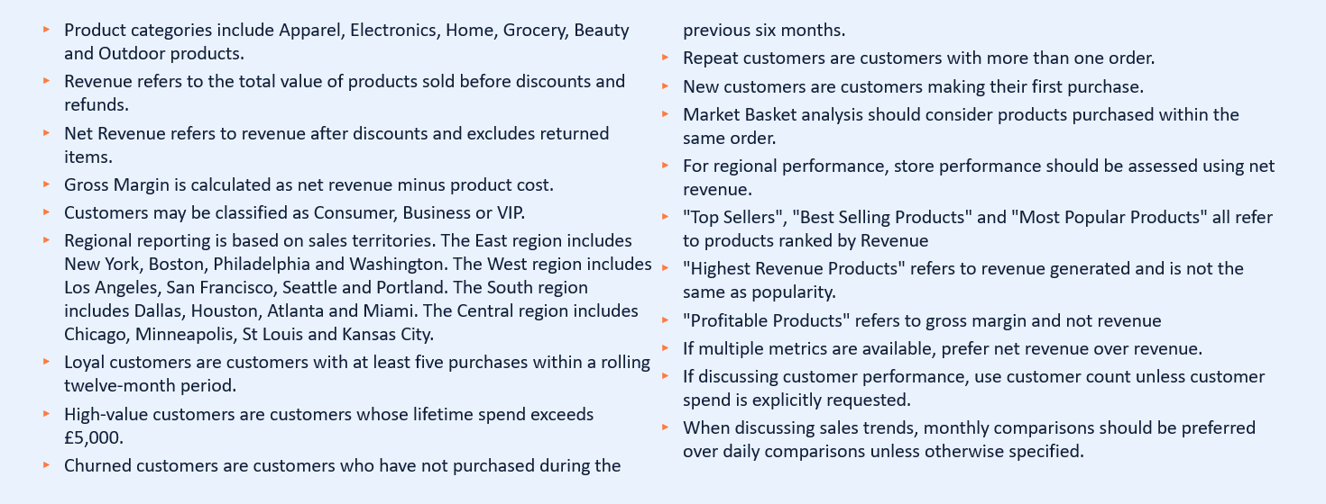
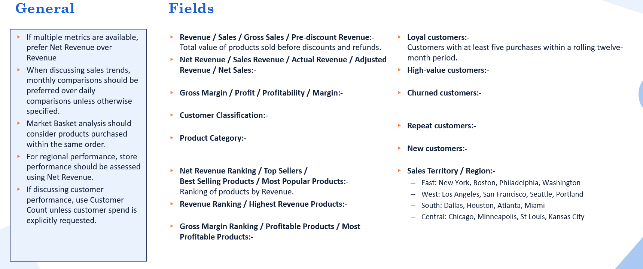
General Instructions first = 273 words to read
Fields instructions first = 212 words to read
>22% more efficient

Slide 14
Genie Governance
PART THREE
Why good Governance is the key to being a Geni(e)us

Slide 15
If your users don’t trust Genie, then they won’t use it
The best way to set yourself up for success with Genie is to define your governance strategy upfront.

Slide 16
Organisations that can answer these questions, are the ones that are going to get success out of Genie
Accountability
Responsibility
Enablement
Who owns Genie and is willing to take accountability for both it’s success and failures within your organization?
Who is taking responsibility for ensuring the accuracy of Genie within the context of your business?
How are you going to enable users to get the most out of Genie, and support them when issues arise?

Slide 17


Slide 18
Summary
PART FOUR
Everything you need to consider to be a Geni(e)us

Slide 19
How to become a Geni(e)us
Agent Design
Documentation
Monitoring
Governance
Align Agents to Data Products
Use Metric Views to their maximum
Use General Instructions sparingly
Keep on top of your UC descriptions
Set and maintain Benchmarks
Monitor user queries for new patterns
Accountability
Responsibility
Enablement

Slide 20


Thank you for listening
Slides available here:
Please add me on LinkedIn – I post tips and tricks every Monday:
Please give Feedback:
/aw2571

